Slide 1




Weekly report: Team Project Development
Week number: 08 – Kick Off
Date: 11/11/2025
Supervisor: Dr. Marina Blohm
Group members: Ahmed Sallam, Luis Urhahn,, Ceren Cetin, Sohail Mansuri
Presenter : Ahmed Sallam

Slide 2
Weekly progress of the team
The new feed in tariff in Syria
Update the wind turbine capital cost
Initial price contributions
First impression to financial indicators
2
Project Development / Optimus Syria

Slide 3
The new feed in tariff in Syria
The new system is divided into four tiers, moving away from universal, heavy subsidies toward cost-recovery for higher consumption
Tier 1: Highly Subsidized (Low-Income)
Tier 3: Exempt from Rationing / Public Institutions
Price: 600 SYP/kWh (approx. 4.6 € cent/kWh).
Limit: Consumption up to 300 kWh per two-month billing cycle.
Subsidy: This rate remains 60% subsidized by the government.
Price: 1,700 SYP/kWh (approx. 13.1 € cent/kWh).
Applies to: Government institutions and companies/factories requiring 24/7 power.
Tier 2: Medium/High Income
Tier 4: High Consumption Industry
Price: 1,400 SYP/kWh (approx. 10.8 € cent/kWh).
Limit: Consumption above 300 kWh per two-month billing cycle.
  Price: 1,800 SYP/kWh (approx. 13.8 € cent/kWh).
  Applies to: High electrical consumption industries (e.g., smelters/heavy manufacturing).
3
Project Development / Optimus Syria

Slide 4
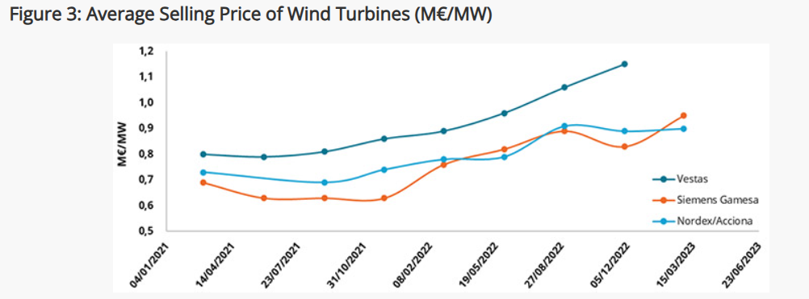
Wind turbine Capex
2021 – Stable Prices
- Vestas: €0.8 million/MW
- Siemens Gamesa: €0.7 million/MW
- Nordex/Acciona: €0.7 million/MW
2022 – Prices Increased
- Vestas: €1.2 million/MW
- Siemens Gamesa: €0.8 million/MW
- Nordex/Acciona: €0.9 million/MW
2023 – Continued Rise
- Vestas: €1.1 million/MW
- Siemens Gamesa: €1.0 million/MW
Chinese Manufacturers
- Less impacted by cost pressures
- Access to local raw materials & subsidies
- Prices around €0.6 million/MW (2022)
- Lower than Western manufacturers
https://www.enerdata.net/publications/executive-briefing/wind-market-share.html
4
Project Development / Optimus Syria

Slide 5
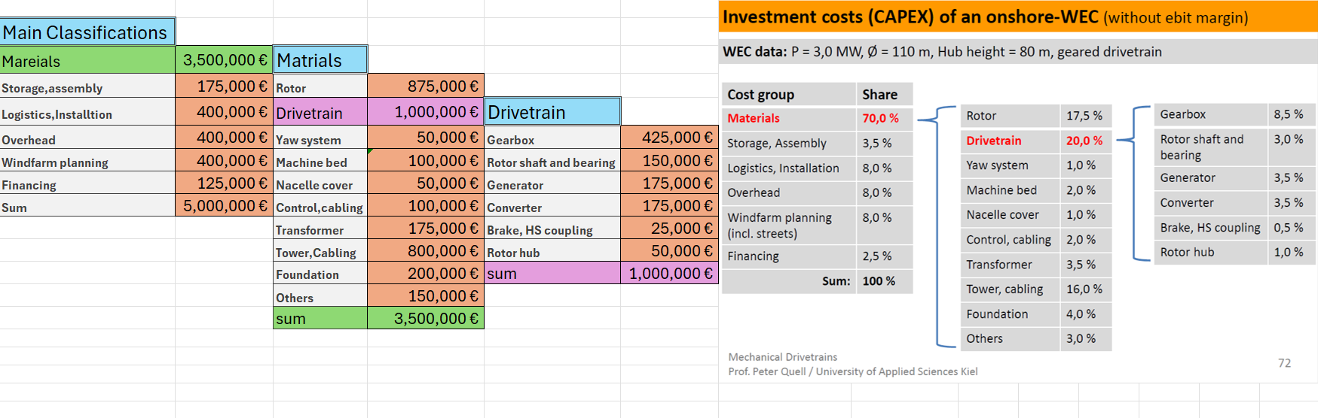
Initial price contributions
5
Notes:
Shows the distances to the surrounding buildings.
In general the distance is longer to the surrounding buildings, especially in the main wind dirction, which is cruicual!
Regarding the buildings A, the shaddow flicker will be a problem, but only in the morning ours.
With the buildings F-H, I am not sure if they are in use. I assume its for farmers or so.
In my opinion its the better side now. Only the amount of water resources could be a major problem, but according to the soil analysis it will not be a problem!

Slide 6
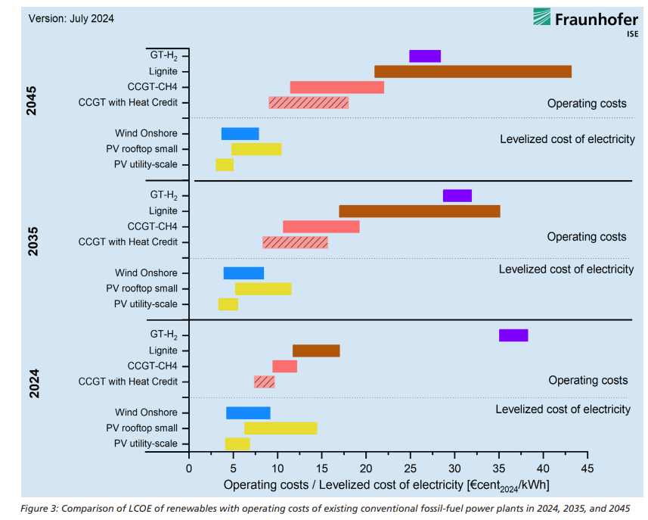
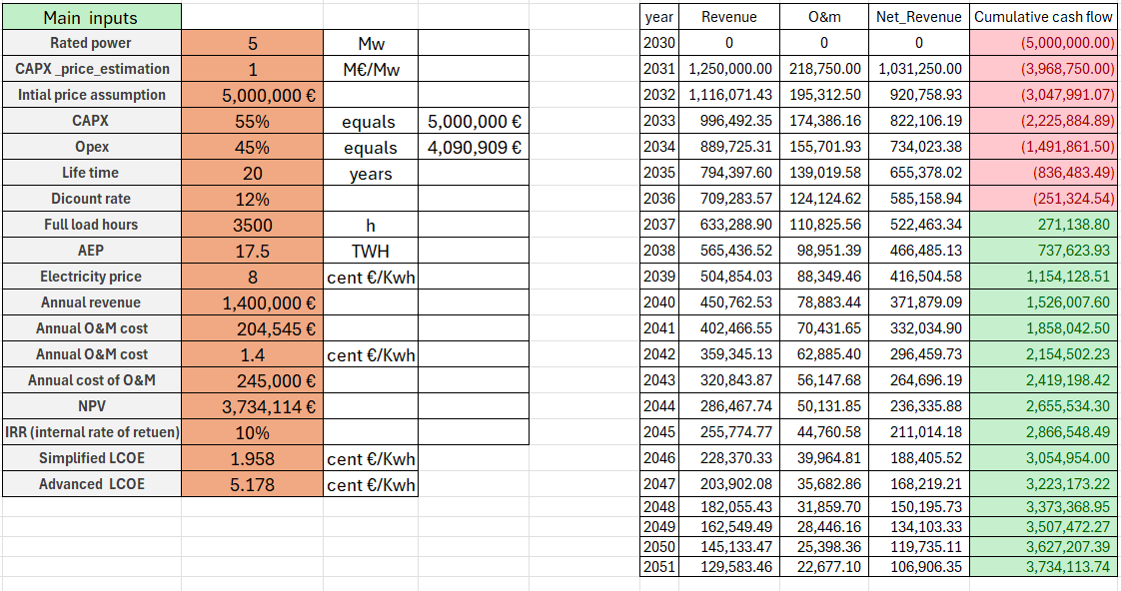
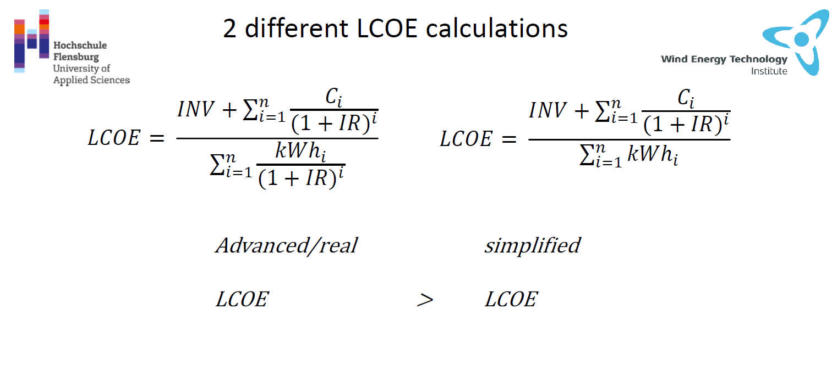
First impression to financial indicators
5

Slide 7
References
file:///D:/windenergei%20master/2nd%20semster/optimus%20project/pdfs/EN2024_ISE_Study_Levelized_Cost_of_Electricity_Renewable_Energy_Technologies.pdf[2] Google Earth, Google Earth Web. [Online]. Available: https://earth.google.com/web/@34.29977563,36.68817928,1384.78342427a,853580.17318904d,35y,0h,0t,0r/data=CgRCAggBOgMKATBCAggASg0I____________ARAA. [Accessed: Sep. 17, 2025].
[3] Google Maps, Google Maps. [Online]. Available: https://www.google.com/maps. [Accessed: Sep. 17, 2025].
[4] Open Infrastructure Map, OpenInfraMap. [Online]. Available: https://openinframap.org/#10.04/33.2058/36.2058. [Accessed: Sep. 17, 2025].
Wind power plant site selection: A systematic review
https://doi.org/10.1016/j.rser.2021.111293/

